Slide 1
301 Oct 8, Class 10
Chapter 9, Research Ethics 1
  Fair and equitable treatment of human research participants

Slide 2
Ethics in Science
Fair and respectful treatment of participants in research
Basic Ethical Principles (Belmont Report)
  Respect for Persons
    Consent is voluntary
    Vulnerable populations are protected
  Beneficence
    Good outweighs the risk
  Justice
    Fairness in distribution

Slide 3
Famous ethical transgressions
Tuskegee Syphilis Study
Guatemala Syphilis
Willowbrook State School Hepatitis studies
Milgram studies
Zimbardo prison studies

Slide 4
Historical Events in Research Ethics
Nuremberg Code, 1947
  Response to Nazi researchers
Declaration of Helsinki, 1964
  Broader statement of principles
Belmont Report, 1979
  Respect for persons
  Beneficence
  Justice
APA Code of Ethics
  Includes integrity

Slide 5
IRB
What is the main goal and purpose of the Institutional Review Board?

Slide 6
Office for Research
Institutional Review Board
  IRB Staff
    Provides preliminary review and feedback
  IRB Panels
    Panels A-E specialize in different research topics
      Including all biomedical research in the Medical School and hospital
    Panel E primarily responsible for psychology research
  IRB Panel members
    NU Faculty members
    One non-NU community member

Slide 7
Informed Consent
Before participating in a research experiment, all participants should generally read and sign an informed consent form. What are 3 main goals of this process intended to maintain ethical standards for the scientific work?

Slide 8
Ethical scientific practice
Assure fair treatment of participants
Institutional Review Board (IRB)
  Reviews all formal research
  Risk/benefit analysis
Informed Consent
  Right to withdraw
  Full disclosure: risks, benefits, procedure
  Privacy

Slide 9

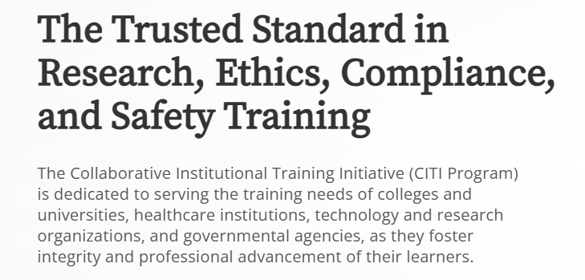
CITI training
Online training in research ethics
  Provides a certificate
Required for all study personnel at NU and many universities
  Behavioral research modules
  Biomedical research modules
Refresh training every 3 years

Slide 10
Why is deception considered an ethically challenging practice in experimental design?
  What do experimenters need to include in the research process if deception is used?
Give an example of a group considered a “vulnerable population” and explain how this affects the process of doing ethical research.

Slide 11
Common risks in psychological science
Deception
  Lying to participants about the experiment
    Sneaky dependent variables
  Sometimes necessary for good design
Privacy
  Protecting identification of participants
  Which condition, whether you were in the study
Frustration/fatigue
Emotional manipulation

Slide 12
Categories of research review
Exempt
  Research, conducted in established or commonly accepted educational settings that specifically involves normal educational practices that are not likely to adversely impact students’ opportunity to learn required educational content or the assessment of educators who provide instruction.
Expedited
  Minimal risk to participants
  Reviewed by a subset of the IRB board
Full Board review
  Anything more than minimal risk (harm, distress, sensitive topics, etc.)

Slide 13
In a study of attitudes about extramarital affairs, a researcher finds that an acquaintance has participated in the study and reports having cheated on their spouse. They then find themselves torn about whether to report this information to the spouse. What kind of research ethics problem has occurred here? What research procedures should be used to keep this from occurring?

Slide 14
Is it research?
Some non-experimental research is non-intrusive
  Observational studies
  Analysis of public health/economic records
Research definition
  “A systematic investigation, including development, testing, and evaluation, designed to develop or contribute to generalizable knowledge”
    Not including: case studies, biography or oral history research, classroom activities, publicly available data

Slide 15
Special cases
Waiver of consent
  Participants are not told they are in a research study
  Requested if scientifically necessary
Recruiting/screening
  Study inclusion criteria can involve sensitive questions
    Bundling trick, “do any of these apply to you?”
  Compensation for participation should not be “coercive”
Animal research, IACUC
  Detailed requirements and procedures for ethical treatment of animals in research

Slide 16
Basic Ethics
Treat your participants with respect and courtesy
Participation is always voluntary
  No matter how much you need more data
  Participants can leave in the middle of the protocol if they wish
Informed consent is always required
  Clearly indicate any possible risks to participants
  Can be very short if there are really no risks
  Consent can be as simple as clicking a button to agree or continue

Slide 17
Midterm Exam
Friday 10/10 at usual class time
Exam can be completed on paper or laptop
  In the classroom or remotely on zoom
  Upload document when finished
Study via prior exams posted on Canvas
  Previous exam questions are posted without answers

